Slide 1
7 IO – Part 1 (2 slots)
Chapter 5
Principles of I/O Hardware Principles of I/O Software I/O Software Layers Disks

Slide 2
Introduction
Processes need data ➔ I/O operations
I/O using hardware ➔ Device dependence
I/O using specific software ➔ slow

Slide 3
Objectives
Principles of I/O Hardware
I/O Devices
Device Controllers
Memory-Mapped I/O
Direct Memory Access (DMA)
Interrupts Revisited
Principles of I/O Software
Goals of the I/O Software
Programmed I/O
Interrupt-Driven I/O
I/O using DMA

Slide 4
Objectives…
I/O Software Layers
Interrupt Handlers
Device Drivers
Device-Independent I/O Software
User-Space I/O Software
Disks
Disk Hardware
Disk Formatting
Disk Arm Scheduling Algorithms
Error Handling
Stable Storage

Slide 5
1- Principles of IO Hardware
I/O Devices
Device Controllers
Memory-Mapped I/O
Direct Memory Access (DMA)
Interrupts Revisited

Slide 6
1.1- I/O Devices
2 categories based on unit of transferred data.
Block devices:
Init size: from 512 bytes to 32.768 bytes.
→ It is possible to read or write each block independently of all the others ones
Hard disks, CD-ROMs, and USB sticks
Character devices
Unit: a character.
→ Stream of characters, without regard to any block structure
Is not addressable and does not have any seek operation
Printers, mice …
The model of block and character devices is general enough that they can be used as a basic for making some OS software dealing with I/O device independent
I/O devices cover a huge range in speeds, which puts considerable pressure on the software to perform well over orders of magnitude in data rates

Slide 7
1.2- Device Controllers
Is an electronic component in I/O units (a chip on the mainboard or a printed circuit card that can be inserted into a expansion slot)
Many controllers can handle 2,4,6 or 8 identical devices
Device 1
Device Controller
CPU
Device 1
Device …
Device n
If the interface between the controller and device is a standard interface (ANSI, IEEE, ISO), then companies can make controllers or devices that fit that interface (ex: IDE, SATA, SCSI, USB, IEEE 1934)
The interface between the controller and the device is often a very low level interface
The controller’s job to convert the serial bit stream into a block of bytes and perform any error correction necessary

Slide 8
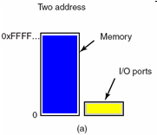
1.3- Memory-Map I/O
Context
Each controller has a few registers that
Can communicate with the CPU.
Allow to read and write
Many devices have a data buffer allow to read and write
→How the CPU communicates with control registers & device data buffers?
First approach
Each control register is assigned an I/O port number, an 8/16 bit integer
The set of all the I/O ports form the I/O port space and is protected
CPU can read contents from PORT to REG (internal register of CPU) and can write the contents from REG to PORT
→ address spaces for memory and I/O are different
Tanenbaum, Fig. 5-2.
Notes:
Problem: Không gian địa chỉ của Memory, khác với không gian địa chỉ của I/O???

Slide 9
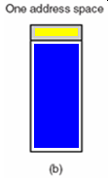
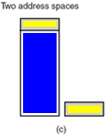
Memory-Map I/O…
Second approach
Map all the control registers into the memory space
Each control register is assigned a particular and unique memory address (Usually, the assigned addresses are at the top of the address space)
→ memory-mapped I/O with one address space (advantage)
Combination approach
A hybrid schema, with memory-mapped I/O data buffers and separate I/O ports for the control registers
Tanenbaum, Fig. 5-2.

Slide 10
Memory-Map I/O…
How do they work?
When the CPU wants to read a word, either from memory or from an I/O port, it puts the address it needs on bus address lines and then asserts a READ signal on a bus' control line
A second signal line is used to tell whether I/O space or memory space is needed
If it is memory space, the memory responds to the request
Else If it is I/O space, the I/O device responds to the request.
If there is only memory space, every memory module and every I/O device compares the address lines to range of addresses that it services
If the address falls in its range, it responds to the request. Since no address is ever assigned to both memory and an I/O device, there is no ambiguity and no conflict

Slide 11
Memory-Map I/O…
Advantages: Direct IO access because:
A I/O device driver can be written entire in C (instead of using complexity assembly code)
No special protection mechanism is needed to keep user processes from performing I/O
Every instruction that can reference memory can also reference control registers (using one instruction instead of two)
Disadvantages
Caching a device control register would be disastrous (thảm hại)-reference from cache instead of devices → ambiguous due to there is some IO devices → disable cache is a solution → slow)
The I/O devices have no way of seeing memory addresses as they go by on the memory bus, so they have no way of responding to them automatically
The need of figuring out at boot time which memory addresses are not really memory addresses

Slide 12
1.4- Direct Memory Access (DMA)
Problem when CPU read byte-by-byte from IO device
Disk controller reads the block from the drive serially, bit by bit, until the entire block is in the controller’s internal buffer
Disk controller computes the checksum to verify that no read errors have occurred
Disk controller interrupts the CPU to let know that those tasks are completed
CPU read the disk block from the controller’s buffer a byte or a word at a time by executing a loop, with each iteration reading on byte or word from controller device register and storing it in main memory
→ waste the CPU’s time
Solution
Using DMA, access directly IO device with no participation of CPU

Slide 13
Direct Memory Access (DMA)…
The DMA controller is integrated into each device
The DMA controller has access to the system bus independent of the CPU
The DMA controller regulates transfers to multiple devices, often concurrently
The acknowledgement is used for each DMA channel to determine the serviced device.
The DMA controller contains several registers
A memory address register
A byte count register
One or more control registers: specify the I/O port to use, the direction of the transfer (read/write from/to I/O device), the transfer unit (byte/word at a time), and the number of bytes to transfer in one burst

Slide 14
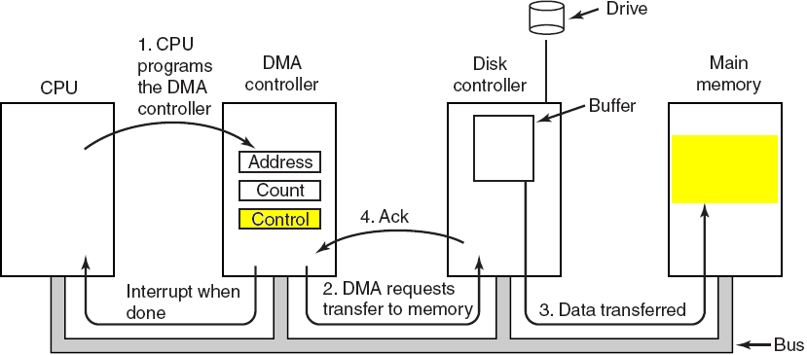
DMA from Disk to Memory
Tanenbaum, Fig. 5-4.
Addess: address in memory will store data
Count: number of bytes
Control: Direction ( increasing/ decreasing address)

Slide 15
DMA Mechanism
Step 1
The CPU sets the DMA controller registers so DMA knows what to transfer where, and how many transfer
The CPU commands the disk controller read data from disk to internal buffer, then verify the checksum
Step 2
The DMA controller initiates the transfer by issuing a read request over the bus to the disk controller
Step 3
The disk controller transfer a word/ byte from internal buffers to main memory at the address that is described in the DMA’s memory address register
Step 4
The disk controller sends an acknowledgement signal to DMA controller when the write is complete
Simultaneously, the DMA controller decides which device to service next (using Round Robin or priority scheme)
In each transfer, the DMA controller increments the memory addresses to use and decrements the byte count
If the byte count is still greater than 0, step 2 through 4 are repeated until the count reaches 0
If the byte equals 0, the DMA controller interrupts the CPU to let it know the transfer is now complete

Slide 16
DMA Modes
Three modes
Word-at-a-time mode
The DMA controller requests for the transfer of and gets one word
Cycle stealing: CPU has to wait the bus because device controller sneaks (lén) in and steals(trộm) an occasional bus cycle from CPU
Block mode ( Burst mode)
DMA tells the device to acquire the bus, issue a series of transfer, then release the bus (efficiently because transfer multiple words)
Disadvantages: It can be blocked the CPU and other devices with long burst is being transfer
Fly-by mode
DMA tells the device controller to transfer the data directly to main memory
To have the device controller send the word to the DMA controller, an extra bus cycle is provided per word transfer
→ Flexible in performing device to device copies and even memory-to-memory copies (first, read to memory, then write to a memory at a different address)
Notes:
Steal: trốn, lén, ăn cắp
Sneak: lén lút

Slide 17
More on DMA
DMA uses physical memory addresses
OS convert the virtual address of the intended memory buffer into a physical address and write this physical address into the DMA controller’s address register
Or, virtual addresses are written into the DMA controller, then DMA must use MMU to have the virtual-to-physical translation
Why does the controller need an internal buffer?
The disk controller can verify the checksum before starting a transfer (Ensuring that the errors do not occur before transferring)
Reduce the administration data in transfer when the bus were busy (then using DMA transfer because the DMA is not time critical)
Is the DMA faster or the CPU faster?
The CPU is faster and can do the job much faster when the limiting factor is not the speed of the I/O device
DMA combines CPU is a saving money solution in low-end computers (e.g. embedded software/ OS)

Slide 18
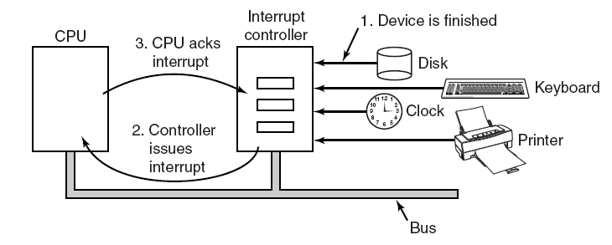
1.5- Interrupts Revisited
More details about interrupts
Interrupt: A signal is sent by an IO device to announce that an IO operation completed.
Acknowlege/ handshake mechanism
Tanenbaum, Fig. 5-5.

Slide 19
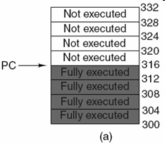
Interrupts…: Precise Interrupts
An interrupt that leaves the machine in a well-defined state
There are 4 properties of precise interrupts
Program Couter (PC) is saved in a known place.
All instructions before the one pointed to by the PC have fully executed.
No instruction beyond the one pointed to by the PC has been executed.
Execution state of the instruction pointed to by the PC is known
Tanenbaum, Fig. 5-6.
There is no prohibition on instructions beyond the one pointed to by the PC from starting.
Any changes make to registers or memory must be undone before the interrupt happens
→ chip is complexity in design

Slide 20
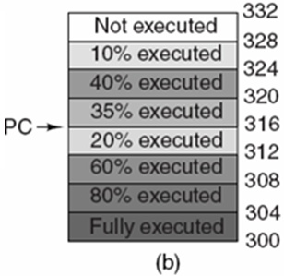
Interrupts…: Precise Interrupts
It’s very hard to meet all requirements as precise due to some tasks execute concurrently➔Different instructions near PC are in different stages of completions.
Machines with imprecise usually vomit (tống ra) a large amount of internal state onto the stack to give the OS the possibility of figuring out what was going on.
Tanenbaum, Fig. 5-6.
→The code necessary to restart the machine is typically extremely complicated.
→Saving a large mount of information to memory on very interrupts make interrupts slow and recovery even worse.

Slide 21
2- Principles of I/O Softwares
User Program
OS
Device
Device dependence
User Program
OS
IO Software
Device
Device independence
Goals of the I/O Software
Programmed I/O
Interrupt-Driven I/O
I/O using DMA

Slide 22
I/O Software : Goals
User Program
OS
IO Software
Device
Device independence
Uniform naming
Error handling
Synchronous (blocking) vs. Asynchronous (interrupt-driven) transfer
Buffering to avoid buffer underrun
Sharing vs. dedicated devices: OS handle to avoid problems
Details in the next slide ( read yourself)
A set of library-functions are prototyped in OS. Hardware manufactures will implement them in their device drivers → Conforming to OS
- Underrun: A condition in which the read/write buffer is fed with data at a slower rate than required → the program or device reading from the buffer to pause its processing while the buffer refills. This can cause undesired and sometimes serious side effects because the data being buffered is generally not suited to stop-start access of this kind. (Wikipedia)

Slide 23
I/O Software : Goals…
Device independence
Write program can access any I/O device without having to specify the device
Uniform naming
The name of file or device should simply be a string or an integer and not depend on the device in any way
A path name is used to address
Error handling
The problem, that are not able to deal with hardware, should be told by software
Synchronous (blocking) vs. Asynchronous (interrupt-driven) transfer
User program write if I/O operation are blocking – after a read system call the program automatically suspended until the data are available in the buffer
The CPU starts transfer &goes off to do something else until the interrupt arrives
Buffering
The data must be put into an output buffer in advance to decouple the rate at which the buffer is filled from the rate at which it is empties, in order to avoid buffer under run
Sharing vs. dedicated devices: OS handle to avoid problems

Slide 24
I/O Software: Programmed I/O
Programmed I/O: I/O operations with participation of CPU
IO Method | Advantage(s) / Disadvantage(s)
Polling or Busy waiting IO: The CPU uses polling to watch the control bit of the device and constantly looping to see whether the device is ready. | Simple. Tying up CPU fulltime until all the IO is done.
Interrupt-driven IO: CPU receives an interrupt when the device is ready. | CPU can do something else while waiting for device If the buffer is not used, interrupt occurs on every character → Performance can decrease.
IO Using DMA: Let the DMA controller fetch the characters to device one at time without the CPU being bothered. | Free ups the CPU during the I/O to do other work and reducing the number of interrupts and most of the time DMA is worth. Special hardware is required.

Slide 25
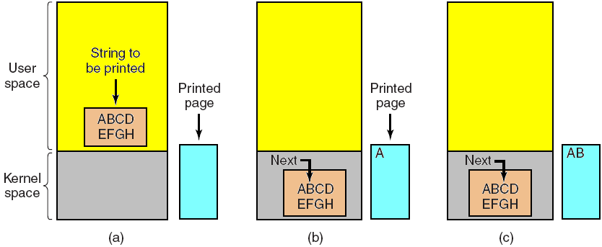
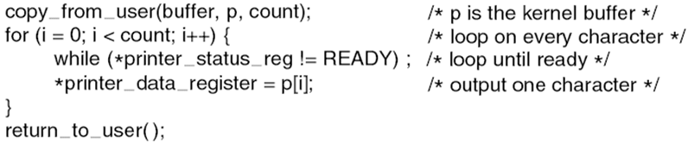
I/O Software: Programmed I/O- Example
Steps in printing a string: (Pooling and Busy waiting is used)
Steps:
Making a system call to open the device
If it is available, the data are copied to kernel
Then, CPU polls the device to see if it is ready to accept or not
If it so, the small data is outputted
Tanenbaum, Fig. 5-7 & 5-8.
Polling or Busy waiting IO

Slide 26
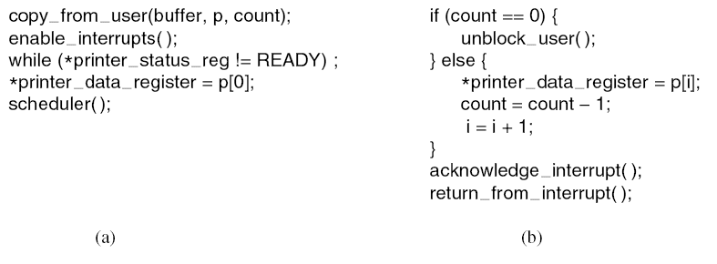
I/O Software : Interrupt-Driven I/O
Steps in printing a string using interrupt-driven IO
Code executed at the time the print system call is made.
Interrupt service procedure for the printer
Tanenbaum, Fig. 5-9.

Slide 27
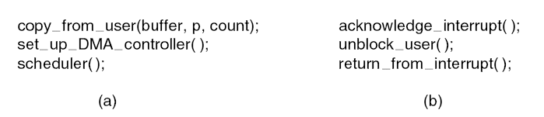
I/O Software: I/O using DMA
DMA is programmed I/O
Printing a string using DMA
Code executed when the print system call is made.
Interrupt service procedure.
Tanenbaum, Fig. 5-10.

Slide 28
3- IO Software Layers (IOSL)
Layers = modules → Maintained, updated easily
Interrupt Handlers
Device Drivers
Device-Independent I/O Software
User-Space I/O Software

Slide 29
I/O Software Layers (IOSL): Overview
There are 4 layers.
Each layer has a well-defined function to perform and a well-defined interface to the adjacent layers
User-level I/O sofware
Device-independent operating system software
Device Drivers
Interrupt Handlers
Hardware
Layers of the I/O software system
Tanenbaum, Fig. 5-11.

Slide 30
IOSL : Interrupt Handlers
Interrupt handler
Is a procedure or routine located at fixed address memory.
Does whatever it has to in order to handle interrupt.
Determines the cause of interrupt.
Performs the necessary processing.
Executes a return from interrupt instruction to return the CPU to the execution state prior to the interrupt.
User-level I/O sofware
Device-independent OS software
Device Drivers
Interrupt Handlers
Hardware

Slide 31
IOSL: Interrupt Handlers – Example
Steps that do occurs after the hardware interrupt has complete may be in a different order on some machines:
(1) Save registers (including Program Status Word) not already been saved by the interrupt hardware.
(2) Set up a context for the interrupt service procedure. (setting up Translation Lookaside Buffer, Memory Management Unit and page table).
(3) Set up a stack for the interrupt service procedure.
(4) Acknowledge the interrupt controller. If there is no centralized interrupt controller, reenable interrupts.
(5) Copy the registers from where they were saved to the process table.

Slide 32
IOSL: Interrupt Handlers – Example…
Steps that do occurs after the hardware interrupt has complete may be in a different order on some machines…
(6) Run the interrupt service procedure. It will extracts information from the interrupting device controller’s register.
(7) Choose which process to run next. If the interrupt has caused some high priority process that was blocked to become ready, it may be chosen to run now.
(8) Set up the MMU context for the process to run next. Some TLB setup may also be needed.
(9) Load the new process’ registers, including its PSW (Program Status Word).
(10) Start running the new process.

Slide 33
IOSL: Device Drivers
Device driver
Is a device-specific code is used to control and attach the I/O device to a computer.
This code is written by the device’s manufacturer and delivered along with the device.
User-level I/O sofware
Device-independent OS software
Device Drivers
Interrupt Handlers
Hardware
Normally handles one device type, or at most, one class of closely related devices.
There is no technical restriction on having one device driver control multiple unrelated devices.
Is written by outsiders, then will be installed in OS.
Are normally positioned below the rest of OS.

Slide 34
IOSL: Device Drivers…
OS classifies drivers into 2 common categories: block devices and character devices.
OS defines a standard interface supporting all block drivers and a second standard interface supporting all character drivers.
Drivers are not allowed to make system calls, but they often need to interact with the rest of the kernel (calls to certain kernel procedures are permitted).

Slide 35
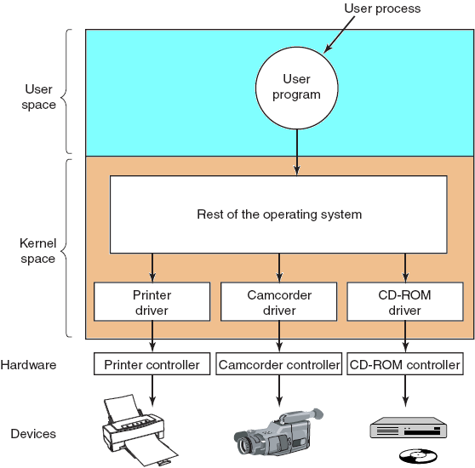
IOSL: Device Drivers…
User-level I/O sofware
Device-independent OS software
Device Drivers
Interrupt Handlers
Hardware
Logical positioning of device drivers. In reality all communication
between drivers and device controllers goes over the bus.
Tanenbaum, Fig. 5-12.

Slide 36
IOSL: Device-Independent I/O Software
The basic function of device-independent software is to perform the I/O functions that are common to all devices and to provide a uniform interface to the user-level software
User-level I/O sofware
Device-independent OS software
Device Drivers
Interrupt Handlers
Hardware
Some functions as
Uniform interfacing for device drivers
Buffering
Error reporting
Allocating and releasing dedicated devices
Providing a device-independent block size

Slide 37
IOSL:Uniform Interfacing for Device Drivers
If each device driver has different interface to the OS
Driver functions available for system to call differ from driver to driver → differ kernel functions
Taken together, interfacing each new driver requires a lot of new programming effort
If all drivers have the same interfaces
It is much easier to plugin a new drivers, providing it conforms to the driver interface
The driver writers know what is expected of them
In practice, not all devices are absolutely identical, but usually there are only a small device types and even these are generally almost the same.

Slide 38
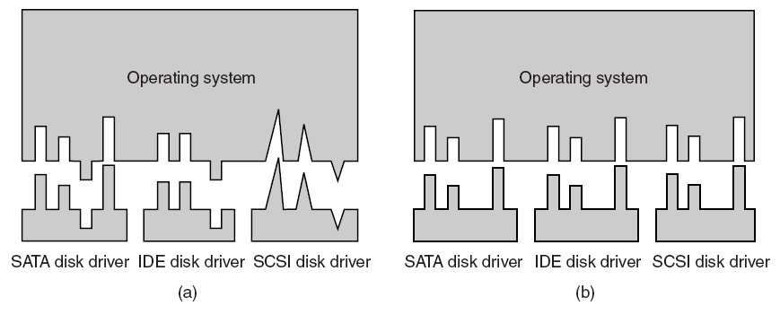
IOSL: Uniform Interfacing for Device Drivers- Demo.
Without a standard driver interface
With a standard driver interface
Tanenbaum, Fig. 5-14.

Slide 39
IOSL:Uniform Interfacing for Device Drivers
For each class devices, the OS defines a set of functions that driver must support.
Often the driver contains a table with pointer into itself for these functions.
When the driver is loaded, the OS records the address of this table of function pointers, so when it needs to call one of the function, it can make an indirect call via this table.
A uniform interface is how I/O devices are named
The device-independent software takes care of mapping symbolic device names onto the proper driver.
In both UNIX and Windows, devices appear in the file system as named objects, which means that the usual protection rules for files also apply to I/O devices.
The system administrator can then set the proper permission for each device.

Slide 40
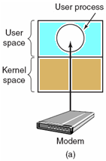
IOSL: Buffering
Problem
Consider a process that wants to read data from a modem. User process do a read system call and block waiting for 1 character and each arriving character causes an interrupt.
The interrupt service hands the character to the user process and blocks it.
Is an issue both for block and character devices?
Unbuffered input
Tanenbaum, Fig. 5-15.
After putting the character somewhere, the process reads another character and blocks again.
➔ a process must run many times for short runs.

Slide 41

IOSL: Buffering…
Buffering in user space
User process provides an n-character buffer in user space
The interrupt service puts the incoming characters in the buffer until it fills up, then wakes up the user processes
Problem
If the buffer is paged out when a character arrives, the buffer could be locked in memory, but if many processes start locking pages in memory, the pool of available pages will shrink and performance will degrade (thoái hoá)
Buffering in user space
Tanenbaum, Fig. 5-15.

Slide 42

IOSL: Buffering…
Buffering inside the kernel
Create a buffer inside the kernel and have the interrupt handler put the characters here.
When the buffer full, the page with the user buffer is brought in, if needed, and the buffer copied there in one operation.
Problem
If the kernel buffer is paged out and the user buffer is brought in when a character arrives, there is no place to put them.
Buffering in the kernel
followed by copying
to user space
Tanenbaum, Fig. 5-15.

Slide 43

IOSL: Buffering…
Double buffering in the kernel
Two kernel buffers is used, while one is being copied to user space, the other is accumulating new input.
Circular buffer
Consists of region of memory and two pointers: one points to the next free work (add new data-Tail), other points to the first word (Head) of data in the buffer that has not been removed yet (remove and process).
Both pointers wrap around, going back to the bottom when they hit the top.
Double buffering in the kernel
Tanenbaum, Fig. 5-15.
B
U
F
F
E
R
Head
Tail

Slide 44
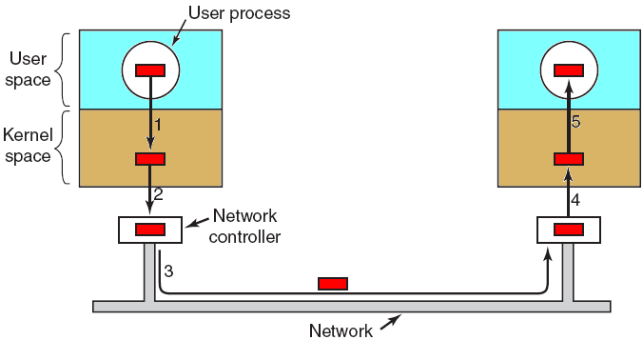
IOSL: Buffering…
Buffering is also important on output
The user is free to reuse the buffer the instant it is unblocked.
Do not block user in long time (enhance performance) to do something.
Networking may involve many copies of a package.
Tanenbaum, Fig. 5-16.
A downside of buffering
If data get buffered too many times, performance suffers (giảm).
Slowdown the transmission rate considerably on copying because all the steps process must happen sequentially.

Slide 45
IOSL:Error Reporting
Many errors are device-specific and must be handled by the appropriate driver, but the framework for error handling is device independent
I/O Errors
Programming errors
Occurs when a process asks for something impossible.
Providing invalid buffer address or other parameter, and specifying an invalid device.
➔ just report back an error code to the caller.
Actual I/O Errors
The driver determines what to do. If it does not know what to do, it may pass the problem back up to device-independent software
When errors occur, the dialog box with message and selected option is showed; or the system display error and terminated.

Slide 46
IOSL: Allocating and Releasing Dedicated Devices
Dedicated devices
Are assigned to only one work at a time.
To handle the accept or reject requested devices
A process performs the open request on the special files for device directly. If the device is unavailable, the open fails. Closing such a dedicated device then released it.
An attempt to acquire a device that is not available blocks the caller instead of failing. Blocked process are put on a queue. Sooner or later, the request device become available and the first process on the queue is allowed to acquire it and continue execution.

Slide 47
IOSL: Device-Independent Block Size
Different disks may have different sector sizes.
It is up to the device-independent software to hide this fact and provide a uniform block size to higher layers by treating several sectors as a single logical block
The higher layers only deal with abstract devices that all use the same logical block size, independent of the physical sector size
Similarly, some character devices deliver their data one byte at the time, while others deliver theirs in larger unit.

Slide 48
IOSL: User-Space I/O Software
Although most of the I/O software is within the OS, a small portion of it consists of libraries linker together with user programs, and even whole programs running outside the kernel.
User-level I/O sofware
Device-independent OS software
Device Drivers
Interrupt Handlers
Hardware
System calls, including the I/O system calls, are normally made by library procedures.
The standard I/O library contains a number of procedures that involve I/O and all run as part of user programs.

Slide 49
IOSL: User-Space I/O Software
Spooling – Cơ chế đường ống
Is a way of dealing with dedicated I/O devices in a multiprogramming system.
A printer is a typical spooled device.
Although it would be technically easy to let any user process open the character special file for the printer, suppose a process opened it and then did nothing for hours, no other process could print anything.
➔ the spooling directory (special directory) and daemon (special process running in background).
To print the file, a process first generates the entire file to be printed and puts it in the spooling directory
It is up to the daemon, which is the only process having permission to use the printer’s special file, to print the files in the directory.

Slide 50
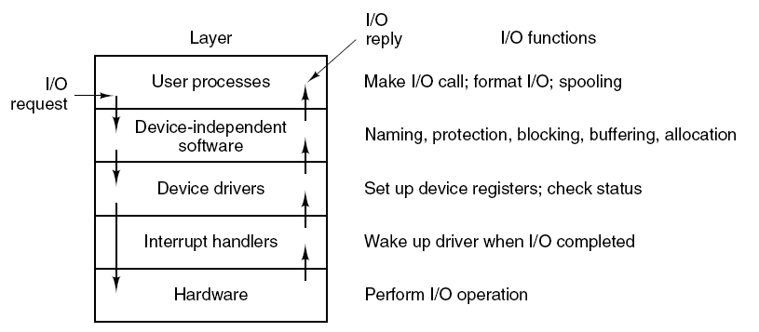
IOSL: Summarize
Layers of the I/O syetem and the main functions of each layer.
Tanenbaum, Fig. 5-17.

Slide 51
4- Disks
Disk Hardware
Disk Formatting
Disk Arm Scheduling Algorithms
Error Handling
Stable Storage

Slide 52
DISKS: Disk Hardware
( Read yourself)
Magnetic Disks
CD-ROMs
Disk Formatting
( On class)
RAID
Some algorithms on disk accessing

Slide 53
DISKS: RAID
Context
Parallel processing is being used more and more to speed up CPU performance. ➔Parallel I/O might be a good idea.
Patterson et al. suggested six specific disk organization that could be used to improve disk performance, reliability, or both (RAID).
Solution: using RAID
Redundant Array of Inexpensive Disks or Redundant Array of Independent Disks
A box full of disks is appeared as a single large disk
All the drives are controlled using a RAID controller
The data are distributed over the drive to allow parallel operation
RAID consists of a SCSI controller ( read as “scuzzy”- Small Computer System interface) ➔ better performance & better reliability
RAID have 6 schemes from level 0 through level 5.

Slide 54
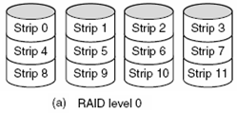
DISKS: RAID Level 0
Striping (phân dải): the virtual single disk is divided up into strips of k sectors each to store data in distributing as
Strip 0: sectors 0 to k – 1
Strip 1: sectors k to 2k – 1
Strip n: sectors nk to (n+1)k – 1
Tanenbaum, Fig. 5-20.
RAID 0 paralleled writes consecutive strips over the drives using Round Robin algorithm
RAID 0 reads the data from consecutive strips as
The software issues a command to read a data block
RAID controller will bread this command into n separate commands, one for each of the n disks, and have them operate in parallel (➔ the parallel I/O without the software knowing about it)
Advantages: Works best with large request, the bigger the better. The performance is excellent and the implementation is straightforward .
Disadvantage: Works worst with the OS asking for data one sector at a time.
Notes:
To strip: gỡ bỏ, thoát y
Strip (n): dải băng

Slide 55
DISKS: RAID Level 0
RAID 0 cần ít nhất 2 ổ đĩa. Tổng quát ta có n đĩa (n >= 2) và các đĩa là cùng loại.
Dữ liệu sẽ được chia ra nhiều phần bằng nhau để lưu trên từng đĩa. Như vậy mỗi đĩa sẽ chứa 1/n dữ liệu.
Ưu điểm: - Tăng dung lượng đĩa: bên ngoài sẽ thấy 1 HDD có dung lượng gấp n lần ổ đĩa đơn. - Tăng tốc độ đọc/ghi đĩa: mỗi đĩa chỉ cần phải đọc/ghi 1/n lượng dữ liệu được yêu cầu. Lý thuyết thì tốc độ sẽ tăng n lần.
Nhược điểm: - Tính an toàn thấp. Nếu một đĩa bị hư thì dữ liệu trên tất cả các đĩa còn lại sẽ không còn sử dụng được. Xác suất để mất dữ liệu sẽ tăng n lần so với dùng ổ đĩa đơn.
Notes:
To strip: gỡ bỏ, thoát y
Strip (n): dải băng

Slide 56
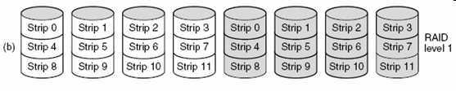
DISKS: RAID Level 1
Duplicates all the disks (n primary disks and n backup disks)
On a write, every strip is written twice (slower than single disk)
On a read, either copy can be used, distributing the load over more drives (faster to twice)
The consistency is excellent (applying to crash or recovery).
Tanenbaum, Fig. 5-20.

Slide 57
DISKS: RAID Level 1
Đây là dạng RAID cơ bản nhất có khả năng đảm bảo an toàn dữ liệu. Cũng giống như RAID 0, RAID 1 đòi hỏi ít nhất hai đĩa cứng để làm việc. Dữ liệu được ghi vào 2 ổ giống hệt nhau (Mirroring). Trong trường hợp một ổ bị trục trặc, ổ còn lại sẽ tiếp tục hoạt động bình thường. Bạn có thể thay thế ổ đĩa bị hỏng mà không phải lo lắng đến vấn đề thông tin thất lạc. Đối với RAID 1, hiệu năng không phải là yếu tố hàng đầu nên chẳng có gì ngạc nhiên nếu nó không phải là lựa chọn số một cho những người say mê tốc độ. Tuy nhiên đối với những nhà quản trị mạng hoặc những ai phải quản lý nhiều thông tin quan trọng thì hệ thống RAID 1 là thứ không thể thiếu. Dung lượng cuối cùng của hệ thống RAID 1 bằng dung lượng của ổ đơn (hai ổ 80GB chạy RAID 1 sẽ cho hệ thống nhìn thấy duy nhất một ổ RAID 80GB).
Tanenbaum, Fig. 5-20.

Slide 58
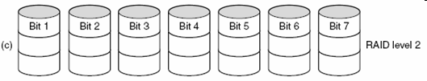
DISKS: RAID Level 2…
Tanenbaum, Fig. 5-20.
Works on word basis, possibly even byte basis.
Split each byte of the single virtual disk into a pair of 4-bit nibbles
Then, add a Hamming code (linear error-correcting code) to each one to form a 7-bit word, of which bits 1, 2, and 4 were parity bits (Hamming code)
All drives were synchronized in terms of arm position and rotational position
Last, it can write 7 bit Hamming coded word over all drive, 1 bit per drive
Advantages
The total throughput was immense (very good) because in one sector time it could write max sectors worth of data (high data rate)
Losing one drive did not cause problems because the Hamming code could handle at runtime
Disadvantages
Requires all drives to be rotationally synchronized, and it only makes sense with a substantial number of drives
Asks a lot of controller since it must do a Hamming checksum every time bit.

Slide 59

DISKS: RAID Level 3
Is a simplified version of RAID level 2.
A single parity bit is computed for each data word and written to a parity drive.
Tanenbaum, Fig. 5-20.
The drives must be exactly synchronized since individual data words are spread over multiple drives.
The drive crashes and a single parity gives only error detection, not error correction, it provides full 1 bit error correction since the position of the bad bit is known.
If a drive crashes, the controller just pretends that all its bit are 0s. If a word has a parity error, the bit accepted from the dead drive must have been a 1.
Advantage: Offer very high data rates
Disadvantage: The number of separate I/O requests per second they can handle is no better than for a single drive.
Notes:
parity bit (n). An extra bit used in checking for errors in groups of data bits transferred within or between computer systems. With PCs, the term is frequently encountered in modem-to-modem communications, in which a parity bit is often used to check the accuracy with which each character is transmitted, and in RAM, where a parity bit is often used to check the accuracy with which each byte is stored.

Slide 60

DISKS: RAID Level 4
Work with strips, not individual words with parity and do not require synchronized drives
Tanenbaum, Fig. 5-20.
RAID 4
Is like RAID 0, with a strip-for-strip parity written onto an extra drive
If a drive crashes, the lost bytes can be recomputed from the parity drive by reading the entire set of drives
Protects the loss of a drive but performs poorly for small updates. If one sector is changed, it is necessary to read all the drives in order to recalculate the parity, which must then be rewritten
Optimization, the old user data and the old parity data is read and recompute the new parity from them → small update requires 2 reads and 2 writes
Disadvantages: bottleneck due to the heavy load on the parity drive

Slide 61
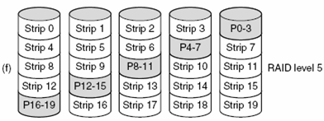
DISKS: RAID Level 5
RAID 5
The bottleneck is eliminated by distributing the parity bits uniformly over all the drives ( RR – Round Robin algorithm)
If the drive crashes, reconstructing the contents of the failed drive is a complex process
Tanenbaum, Fig. 5-20.

Slide 62
DISKS:RAID Level 4 & Level 5
RAID 5 là sự cải tiến của RAID 0 nhưng có thêm (ít nhất) một ổ đĩa cứng chứa thông tin có thể khôi phục lại dữ liệu đã hư hỏng của các ổ đĩa cứng RAID 0. Giả sử dữ liệu A được phân tách thành 3 phần A1, A2, A3, khi đó dữ liệu được chia thành 3 phần chứa trên các ổ đĩa cứng 0, 1, 2 (giống như RAID 0). Phần ổ đĩa cứng thứ 3 chứa dữ liệu của tất cả để khôi phục dữ liệu có thể sẽ mất ở ổ đĩa cứng 0, 1, 2. Giả sử ổ đĩa cứng 1 hư hỏng, hệ thống vẫn hoạt động bình thường cho đến khi thay thế ổ đĩa cứng này. Sau khi gắn nóng ổ đĩa cứng mới, dữ liệu lại được khôi phục trở về ổ đĩa 1 như trước khi nó bị hư hỏng.
Yêu cầu tối thiểu của RAID 5 là có ít nhất 3 ổ đĩa cứng.

Slide 63
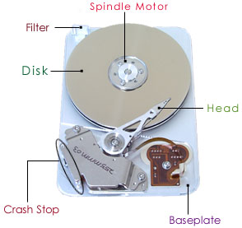
DISKS : Disk Arm Scheduling Algorithms
How long disk drivers to read or write a disk block?
The time required is determined by 3 factors:
Seek time (the time to move the arm to the proper cylinder)
Rotational delay (the time for the proper sector to rotate under the head)
Actual data transfer time
For most disks, the seek time dominates the other two times, so reducing the mean seek time can improve system performance substantially.

Slide 64
DISKS: Disk Arm Scheduling Algorithms First-Come, First-Served (FCFS)
Process request sequentially
Is intrinsically fair, but it generally does not provide the fastest service
Ex:
Assume that the disk head is initially at cylinder 53
A disk queue with requests for I/O blocks on cylinders in orders
98, 183, 37, 122, 14, 124, 65, 67
Positions: 53 98 183 37 122 14 124 65 67
Total head movement of 640 ((98-53)+(183-98)+(183-37)+(122-37)+(122-14)+ (124-14) + (124-65)+(67-65))
Average Seek length: 640/8 = 80

Slide 65
DISKS:Disk Arm Scheduling Algorithms Shortest Seek First (SSF)
Select the disk I/O request that requires the least movement of the disk arm from its current head position
➔ Always choose the minimum seek time
Ex:
Assume that the disk head is initially at cylinder 53
A disk queue with requests for I/O blocks on cylinders in orders 98, 183, 37, 122, 14, 124, 65, 67
Positions: 53 65 67 37 14 98 122 124 183
Total head movement of 236 ((65-53)+(67-65)+(67-37)+(37-14)+(98-14)+(122-98)+(122-124)+(183-124))
Average seek length: 236/8 = 29.5

Slide 66
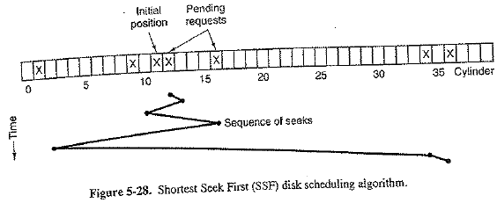
DISKS:Disk Arm Scheduling Algorithms Shortest Seek First (SSF)

Slide 67
DISKS: Disk Arm Scheduling Algorithms Shortest Seek First (SSF)
Problems
When the SSF is proceeding, the new request, that will have priority overall or next selection, appears. The arm will next go to the new request.
With a heavily loaded disk, the arm will tend to stay in the middle of the disk most of the time, so requests at either extreme will have to wait until a statistical fluctuation (dao động bất thường) in the load causes there to be no request near the middle. → Request far from the middle may get poor services. The goals of minimal response time and fairness are in conflict here.

Slide 68
DISKS: Disk Arm Scheduling Algorithms Elevator algorithm
Arm moves in one direction only, satisfying all outstanding requests until it reaches the last track in that direction.
After all disk requests at one direction are served, th direction is reversed. (Demo: figure 5-29, Tannenbaum)
Requires the software to maintain 1 bit: the current direction bit, UP or DOWN
When a request finishes, the disk or elevator driver checks the bit.
If it is UP, the arm or the cabin is moved to the next highest pending request
If no requests are pending at higher positions, the direction bit is reversed
When the bit is set to DOWN, the move is to the next lowest request position, if any.

Slide 69
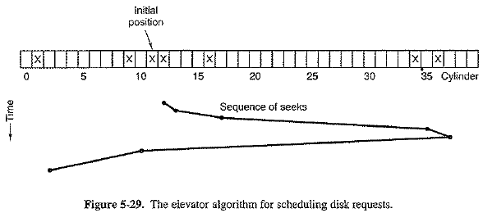
DISKS: Disk Arm Scheduling Algorithms Elevator algorithm

Slide 70
DISKS: Disk Arm Scheduling Algorithms Elevator algorithm
Ex:
Assume that the disk head is initially at cylinder 53
A disk queue with requests for I/O blocks on cylinders in orders
98, 183, 37, 122, 14, 124, 65, 67
Positions with bit is DOWN:
53 37 14 65 67 98 122 124 183
Total head movement of 208 ((53-37)+(37-14)+(65-14)+(67-65)+(98-67)+(122-98)+(124-122)+(183-124))
Average Seek Length: 208/8 = 26
Positions with bit is UP:
53 65 67 98 122 124 183 37 14
Total head movement of 299 ((65-53)+(67-65)+(98-67)+(122-98)+(124-122)+(183-124)+(183-37)+(37-14))
Average Seek Length: 299/8 = 37.375
Nice propery of the elevetor algorithm: Given any collection of requests, the upper bound on the total motion is fixed: it is just twice the number of cylinders.

Slide 71
DISKS: Elevator algorithms- Modification
A slight modification of elevator algorithms that has a smaller variance in response time is to always scan in the same direction.
When the highest numbered cylinder with a pending request has been services, the arm goes to lowest number cylinder with a pending request and then continues moving in an upward direction.
In effect, the lowest-number cylinder is thought of as being just above the highest-number cylinder
Ex:
Assume that the disk head is initially at cylinder 53
A disk queue with requests for I/O blocks on cylinders in orders
98, 183, 37, 122, 14, 124, 65, 67
Positions: 53 65 67 98 122 124 183 14 37
Total head movement of 153(?) ((65-53)+(67-65)+(98-67)+(122-98)+(124-122)+(183-14)+(37-14))
Average Seek Length: 153/8 = 19.125

Slide 72
DISKS: Disk Arm Scheduling Algorithms
Some disks controller provide a way for the software to inspect the current sector number under the head
If two or more requests for the same cylinder are pending, the driver can issue a request for the sector that will pass under the head next
The controller can select any of its heads almost instantaneously (tức thời)
If the seek time is much faster than the rotational delay
Pending request should be sorted by sector number, and as soon as the next sector is about to pass under the head, the arm should be zipped over the right track to read or write it
When several drives are present on the same controller, the OS should maintain a pending request table for each drive separately
Whenever any drive is idle, a seek should be issued to move its arm to the cylinder where it will be needed next
When the current transfer finishes, a check can be made to see if any drives are positioned on the correct cylinder
If one or more are, the next transfer can be started on a drive that is already on the right cylinder
If none of the arms is in the right place, the driver should issue a new seek on the drive that just completed a transfer and wait until the next interrupt to see which arm gets to its destination first

Slide 73
DISKS: Disk Arm Scheduling Algorithms
All the disk scheduling algorithms tacitly assume that the real disk geometry is the same as the virtual geometry.
If it is not, then scheduling disk requests makes no sense because the OS cannot really tell whether cylinder 40 or cylinder 200 is closer to cylinder 39.
On the other hand, if the disk controller can accept multiple outstanding requests, it can use these scheduling algorithms internally. In that case, the algorithms are still valid, but one level down, inside the controller.

Slide 74
DISKS : Error Handling
Bad sector
Sectors do not correctly read back the value just written to them.
If the defect (khuyết điểm) is very small, the bad sector can be used.
Otherwise, the error cannot be masked.
Substituted the bad sector:
Controllers
Remap the bad sector to the spare.
Shift all the sectors up one .
The information about the substitution of the bad sector is kept track through internal tables or by rewriting the preambles to give the remapped sector numbers (besides, the data must be copied).
When defect occurs at normal operation (may be specks of dust), if getting repeated errors on a certain sector, controller can switch to a spare before the sector has died completely.
OS
Must first acquire a list of bad sectors, either reading them from the disk, or simply testing the entire disk itself.
Once it knows, the OS can build remapping tables.
Notes:
Speck of dust: hạt bụi

Slide 75
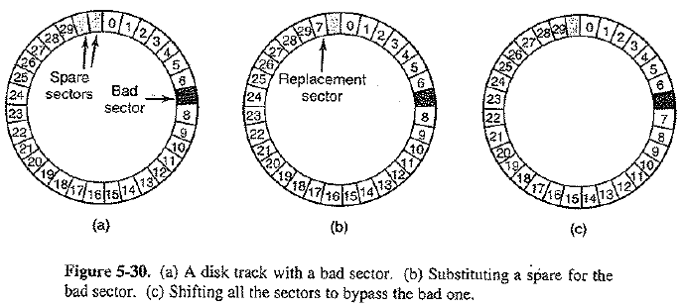
DISKS: Error Handling
Bad sector (cont)
Problem: backup
File to file: OS has to hide the bad block file so well that even a backup utility cannot find it.
Sector to Sector: impossible except that the only hope that the backup program has enough smarts to give up after 10 failed reads and continue with next sector.

Slide 76
DISKS: Error Handling
Seek errors
Caused by mechanical problems in the arm occur.
The controller keeps track of the arm position internally.
To perform seek, it issues a series of pulses to the arm motor, on pulse per cylinder, to move the arm to the new cylinder.
When the arm gets to its destination, the controller reads the actual cylinder number from the preamble of the next sector.
If the arm is in the wrong place, a seek error has occurred.
Solutions
Most hard disk controller correct seek errors automatically, but most floppy controllers just set an error bit and leave the rest to the driver.
The driver handles this error with particular command to move the arm as far out as it will go and reset the controller’s internal idea of the current cylinder to 0.
If it does not, the driver must be repaired.

Slide 77
DISKS: Stable Storage
A system has the following properties:
When a write is issues to it, the disk either correctly writes the data or it does nothing, leaving the existing data intact (nguyên vẹn)
Is implemented in software.
The goal is to keep the disk consistent at all costs.
Assumes of a possible-error model:
Errors can not detected at the disk writes but a subsequent read.
A correctly written sector can spontaneously (tự phát) go bad and become unreadable ➔ small enough to ignore (so rarely).
When a disk write fails, CPU just stops → incorrect data in one sector and an incorrect ECC (error-correction code) that can later be detected.
Under all these conditions, stable storage need to be made 100% reliable in the sense of writes either working correctly or leaving the old data in place.

Slide 78
DISKS : Stable Storage
Uses a pair of identical disks with the corresponding blocks working together to form one error-free block
In the absence of errors, the corresponding blocks on both drives are the same.
Either one can be read to get the same result
Three operations are defined to archieve this goal: Stable writes / Stable read / Crash recovery

Slide 79
DISKS : Stable Storage
Stable writes: Write and read for checking
Write block on drive 1, then reading it back to verify written correctly.
If not correctly, the write and reread are done again up to n times until they work.
After n consecutive failures, the block is remapped onto a spare and the operation repeated until it succeeds, no matter how many spare have to be tried.
After succeeded on drive 1, the driver 2 is written and reread until it succeeds.
In the absence of CPU crashes, when a stable write completes, the block has correctly been written onto both drives and verified on both of them.

Slide 80
DISKS: Stable Storage
Stable reads
The read will read the block on drive 1 first
If ECC is incorrect, the read is tried again up to n times.
If all of these reads give bad ECCs, it reads on drive 2.
Given the fact that a successfully stable write leaves 2 good copies of the block behind, and our assumption that the probability of the same block spontaneously going bad on both drives in a reasonable time interval is negligible (không đáng kể), a stable read always succeeds.
ECC: Error-Correction Code

Slide 81
DISKS: Stable Storage
Crash recovery
After a crash, a recovery program scans both disks comparing corresponding blocks.
If a pair of blocks are both good and the same, nothing is done.
If one of them has an ECC error, the bad block is overwritten with the good blocks.
If a pair of blocks are good but different, the block from driver 1 is written onto drive 2.
In the absence of CPU crash, stable storage always works because stable writes always write two valid copies of every block and spontaneous errors are assumed never to occur both corresponding blocks at the same time.

Slide 82
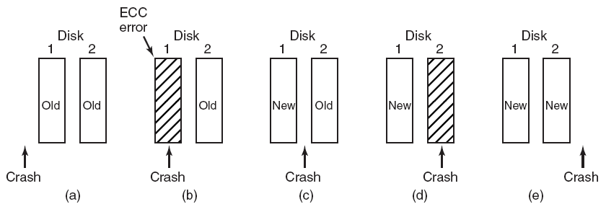
DISKS : Stable Storage
Situation: Data is written to 2 disks, disk 1 first then disk 2
Analysis of the influence of crashes on stable writes
(5 situations when the crash occurs.)
Tanenbaum, Fig. 5-31.

Slide 83
DISKS : Stable Storage
Optimizations and improvements
Comparing all the blocks pairwise after a crash: doable but expensive
→A huge improvement is to keep track of which block was being written during a stable write so that only one block has to be checked during recovery.
In system with Nonvolatile RAM:
The stable write can put the number of block in RAM before starting the write.
After completed, the block number in RAM is overwritten with an invalid block.
Under these conditions, after a crash the recovery can check RAM to see if a stable write happened to be in progress during the crash.
➔ Two copies of the block can then be checked for correctness and consistency.

Slide 84
DISKS : Stable Storage
Optimizations and improvements…
If nonvolatile RAM is not available
At the start of a stable write, a fixed disk block on drive 1 is overwritten with the number of block to be stably written. Then read back and verify.
If is so, write 2 and verify.
After completed, both blocks are overwritten with a valid block number and verified ( in the book of Tanenbaum invalid).
➔ After a crash, it is easy to determine whether or not a stable write was in progress during the crash.
➔ It requires eight extra disk operations to write a stable block ➔ should be used exceeding sparingly (dùng hạn chế).
Notes:
Sparing: tiết kiệm, hạn chế

Slide 85
Summary
Principles of I/O Hardware
Principles of I/O Software
I/O Software Layers
Disks
Q&A

Slide 86
Your work
Write down main idea of this lesson.
If you do not, you will br considered as absent in the next class.

